Slide 1
Chapter 14
Switching
Circuit Switching
Packet Switching
Message Switching
WCB/McGraw-Hill
© The McGraw-Hill Companies, Inc., 1998

Slide 2
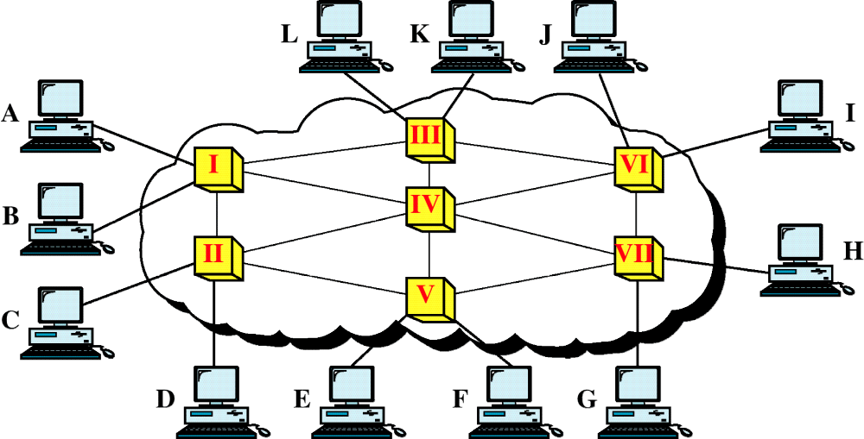
Figure 14-1
Switched Network
WCB/McGraw-Hill
© The McGraw-Hill Companies, Inc., 1998

Slide 3
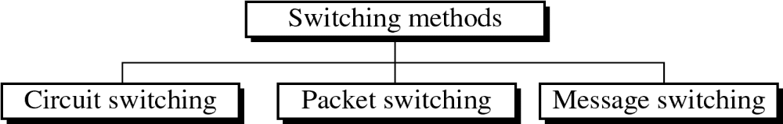
Figure 14-2
WCB/McGraw-Hill
© The McGraw-Hill Companies, Inc., 1998

Slide 4
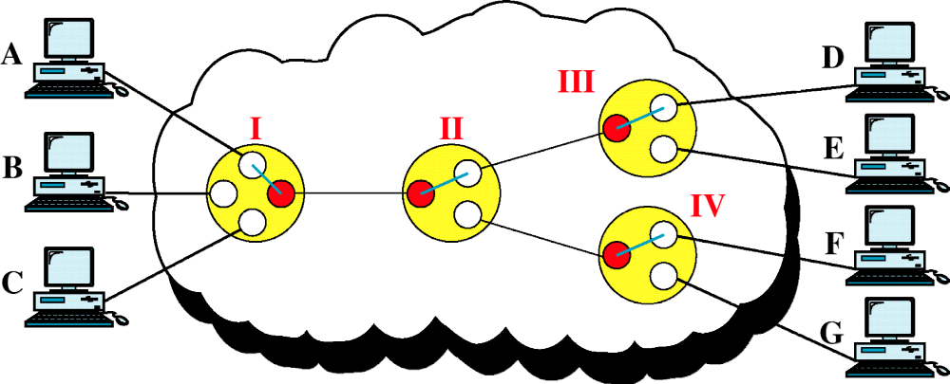
Figure 14-3
Circuit-Switched Network
WCB/McGraw-Hill
© The McGraw-Hill Companies, Inc., 1998

Slide 5
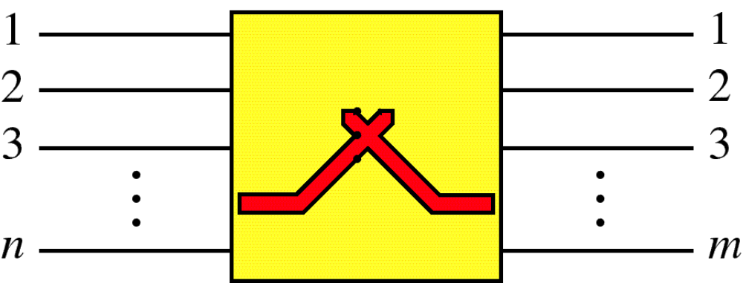
Figure 14-4
Switch
WCB/McGraw-Hill
© The McGraw-Hill Companies, Inc., 1998

Slide 6
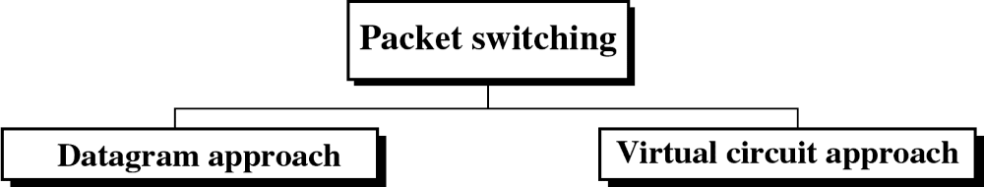
Figure 14-13
WCB/McGraw-Hill
© The McGraw-Hill Companies, Inc., 1998

Slide 7
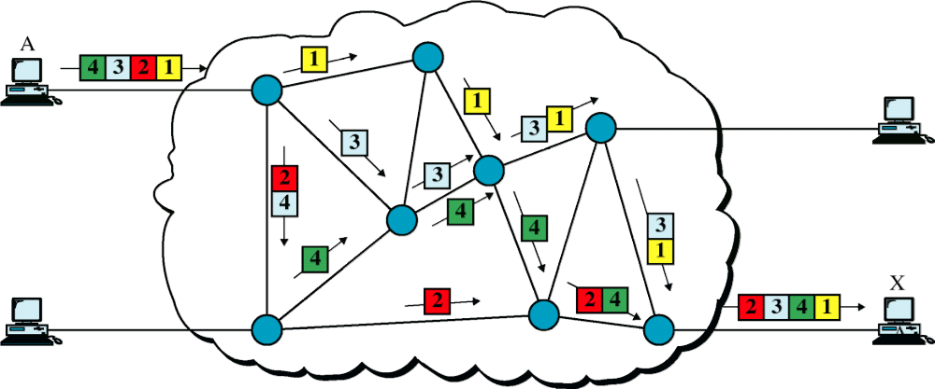
Figure 14-14
Datagram Approach
WCB/McGraw-Hill
© The McGraw-Hill Companies, Inc., 1998

Slide 8
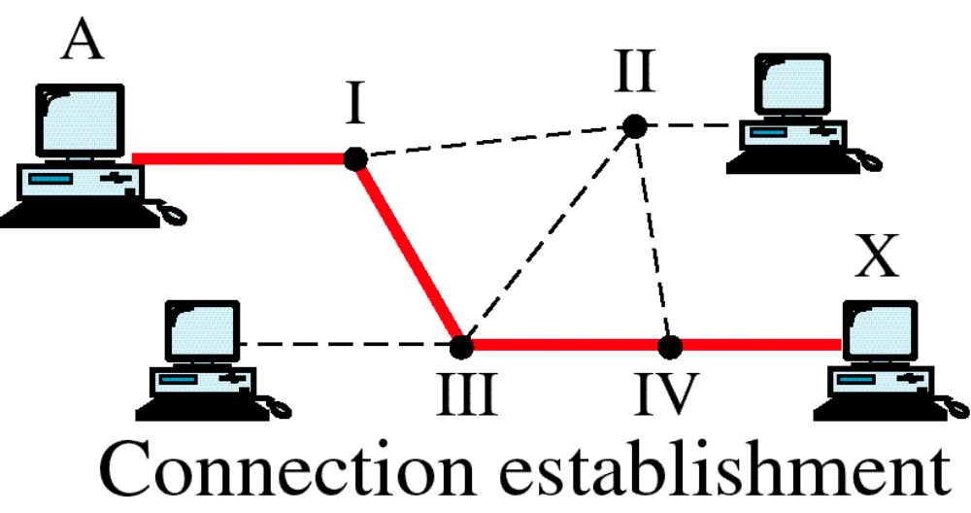
Figure 14-16
Switched Virtual Circuit
WCB/McGraw-Hill
© The McGraw-Hill Companies, Inc., 1998

Slide 9
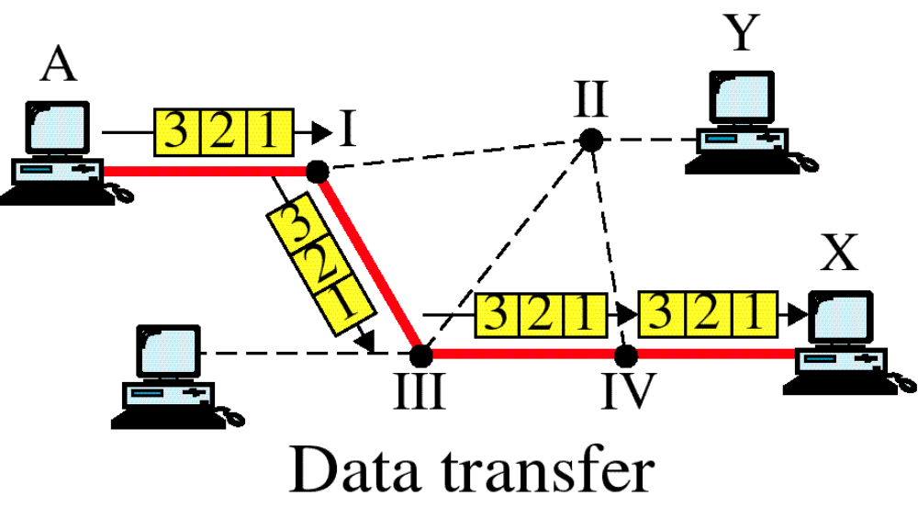
Figure 14-16-continued
Switched Virtual Circuit
WCB/McGraw-Hill
© The McGraw-Hill Companies, Inc., 1998

Slide 10
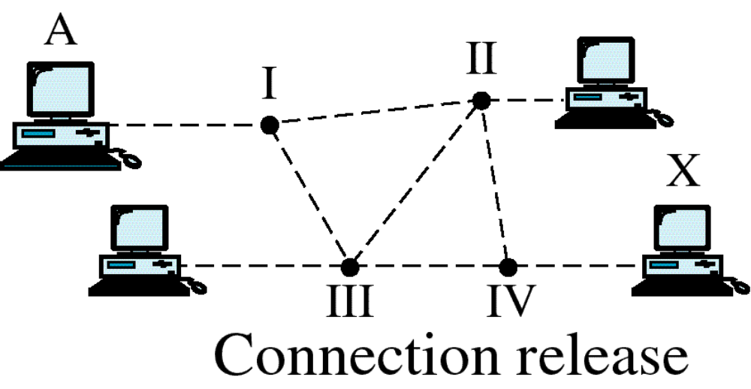
Figure 14-16-continued
Switched Virtual Circuit
WCB/McGraw-Hill
© The McGraw-Hill Companies, Inc., 1998

Slide 11
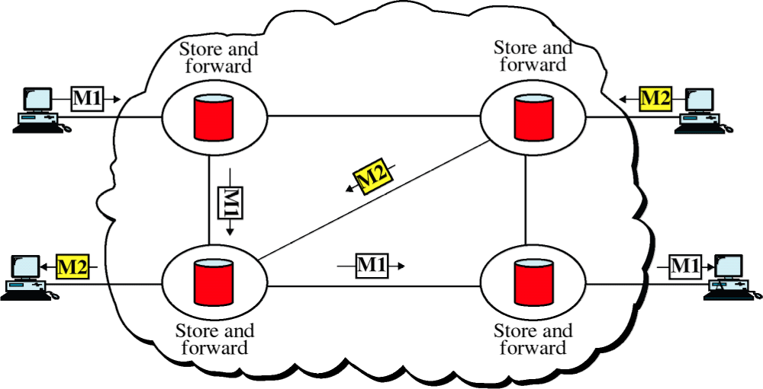
Figure 14-17
Message Switching
WCB/McGraw-Hill
© The McGraw-Hill Companies, Inc., 1998

